Slide 1

John Doe
DH 290 Case study
November 21st, 2025
Mrs. Merritt
Dental Hygiene Clinic
Missouri Southern State University
By: Taylor Yeoman

Slide 2

Section 1
Basic Information

Slide 3
General Characteristics of patient
Patient name: John Doe
Patient ID number: 15700
Age: 42 years old
Gender: Male
Race/ ethnicity: Hispanic
The patient’s chief complaint: No chief complaint

Slide 4
Social history
Marital Status: Married
Occupation: Producer/ Musician
Children: Four
Education: High School Diploma

Slide 5
Dental history Summary
Symptoms: Patient does not report with any pain
Last dental visit: Patient has never been to the dentist until previously going to Access where they stated he needed a deep cleaning. He got an FMX there on September 25 but could not get in for a cleaning due to limited booking, and them booking him months out.
Routine oral hygiene: Brushes with a soft end manual toothbrush twice a day and flosses trice a day.

Slide 6

Economic influences
Socieconomic status: middle class
Dental insurance: the patient does not have insurance
Patients' attitude & behavior: Mr. Doe is very consistent with coming in and is adamant about getting his teeth cleaning. The translator informed to me that he is looking forward to having his teeth cleaned and maintaining his oral hygiene.

Slide 7
Section II
Objective Data

Slide 8
Health history
The patient does not have any medical conditions
No surgeries
Allergies: none

Slide 9
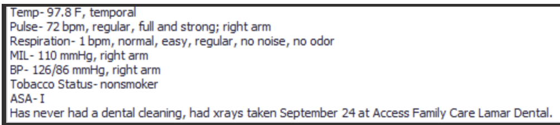
Medical history summary
First appointment : 10/21/2025
Patient presents with no surgeries, medications, & allergies

Slide 10
Eoio Finding Head’s tab
Extra-oral exam: 10/09/2025
- bilateral mobile palpable nontender submandibular lymph nodes
- generalized macules 1x1 on face, ear, & neck
Intra-oral exam:
-bilateral Fordyce granules
-hyperpigmentation labium inferius
- slight maxillary tori
- right mandibular tori
- white coating on the dorsal surface of tongue
- lesion right lateral surface of tongue
- bilateral linea alba

Slide 11
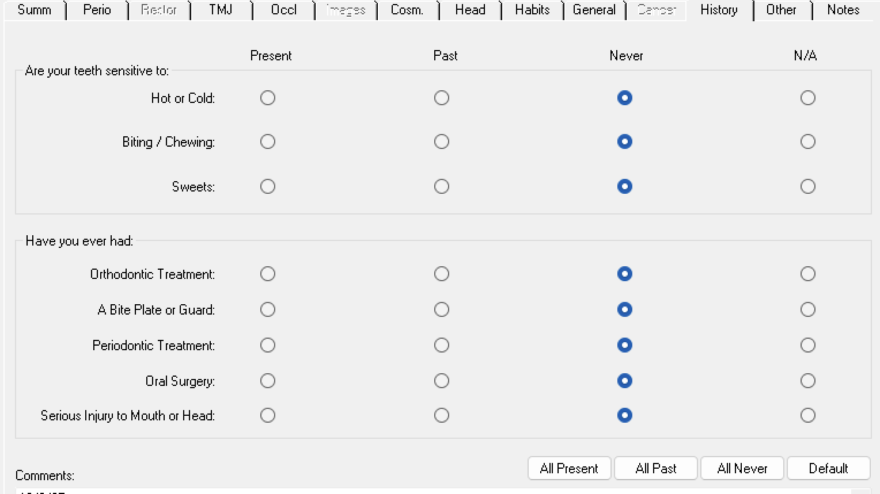
History tab & General Tab
There was no concerns on the history tab.
The patient uses a soft end toothbrush and brushes twice daily. Patient also flosses twice daily.

Slide 12
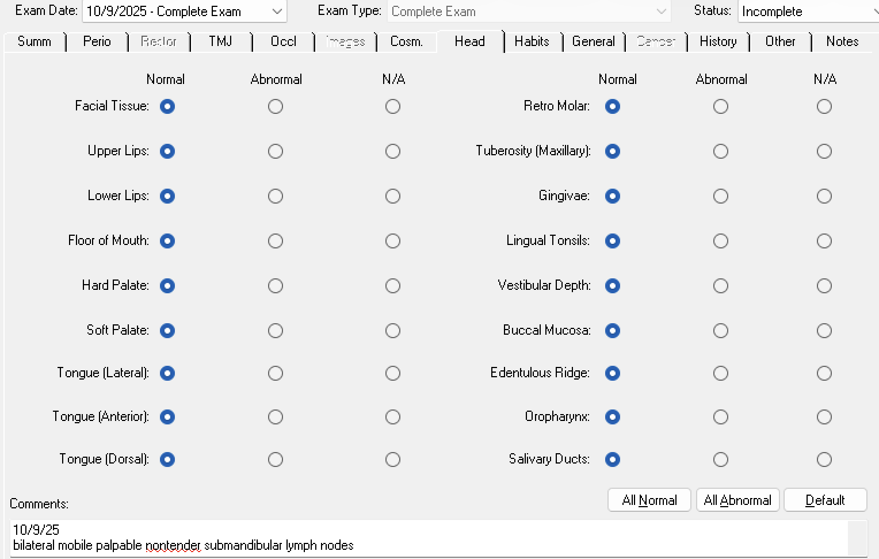
Head Tab

Slide 13
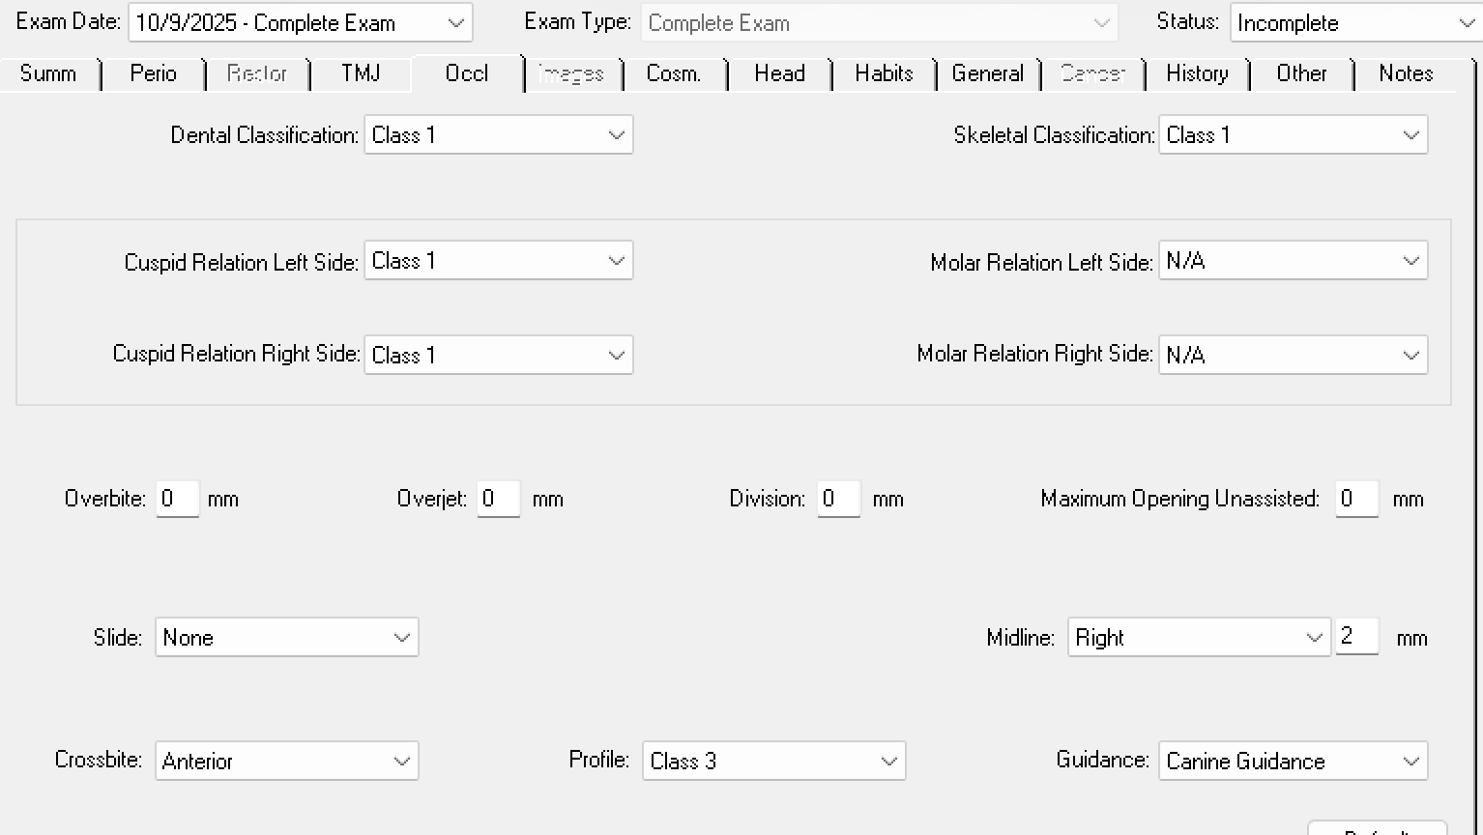
Cosmetic and occlusion tab
Occlusion Tab- 10/09/25
Overbite: Moderate
Overjet: 2 mm
Midline: Right 2 mm
Cusp relation: Class I
Cosmetic: generalized yellow marginal intrinsic stain.
Generalized moderate to severe attrition with localized brown stain/ possible decay on 17,31, &32.
#7 facial white spot hypomineralization
Slight crowding maxillary and mandibular anteriors
18,19,20 linguoverted, #4 and 13 rotated

Slide 14
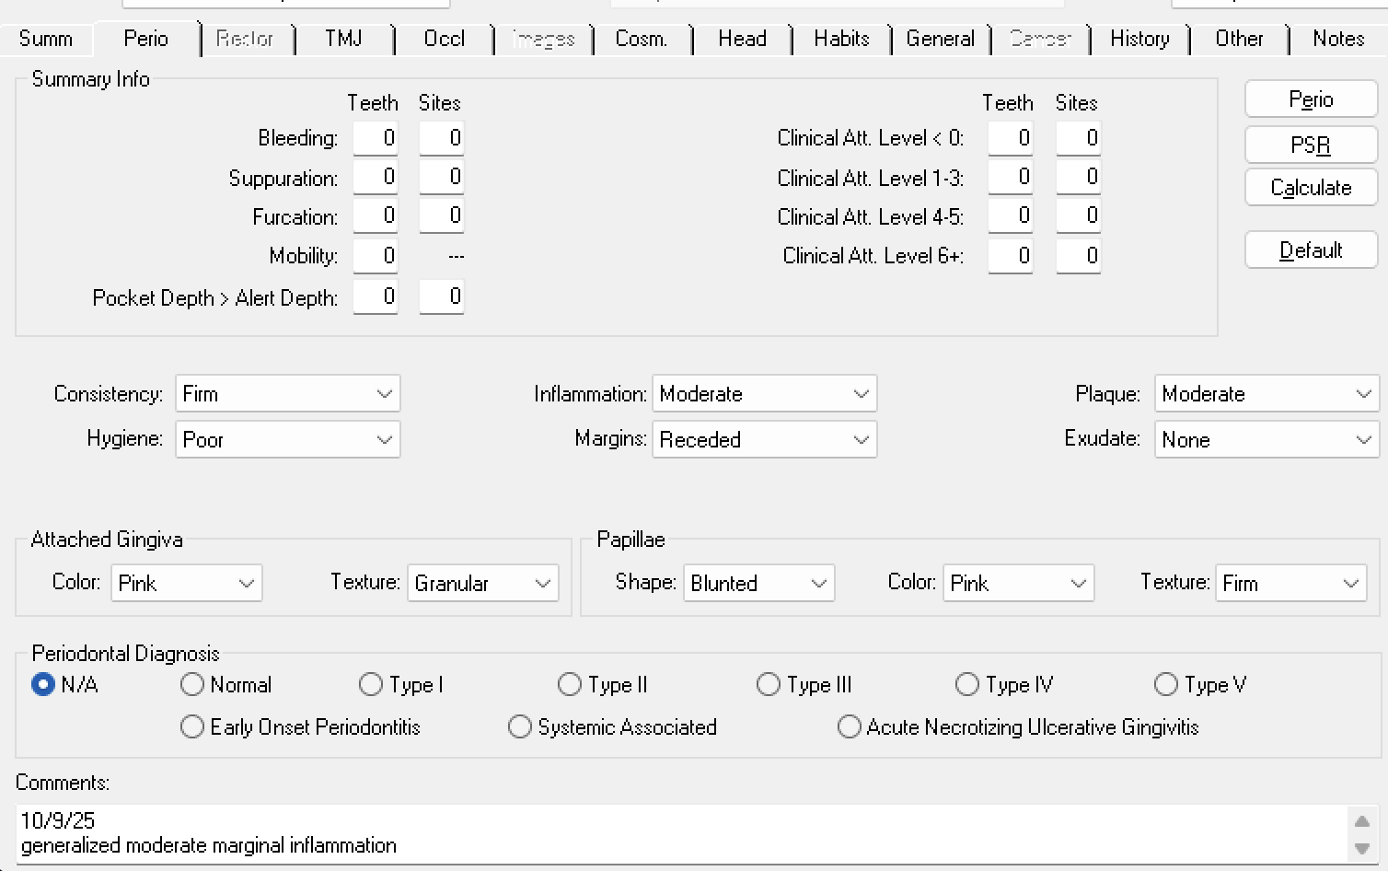
TMJ and perio tab
TMJ; left pops opening but with no other pain concerns
Gingival statement: Generalized moderate marginal inflammation

Slide 15
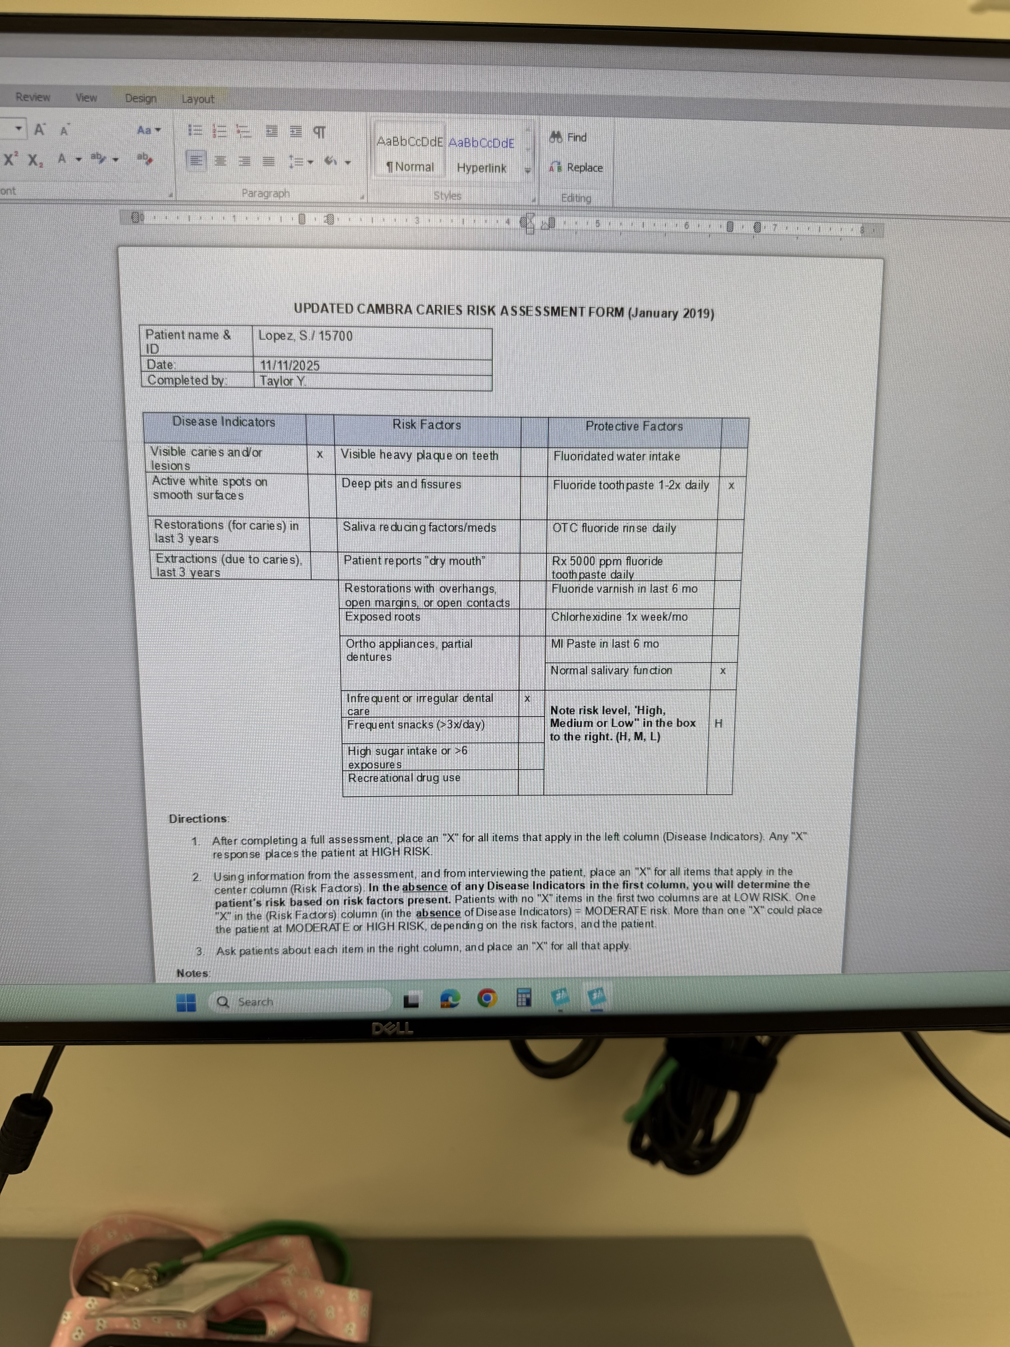
Caries risk assessment
Disease Indicators: Patient has visible caries and decay interproximal on several teeth
Risk Factors: Patient has irregular dental visits
Protective Factors: Use of OTC fluoride with normal salivary function

Slide 16
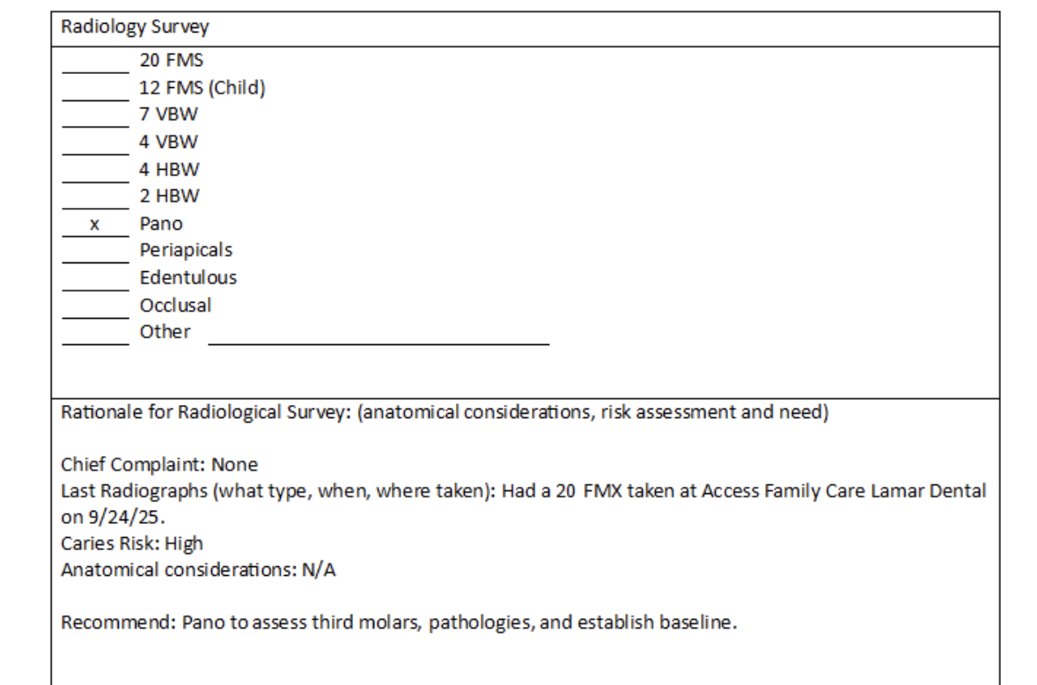
Radiology treatment plan

Slide 17
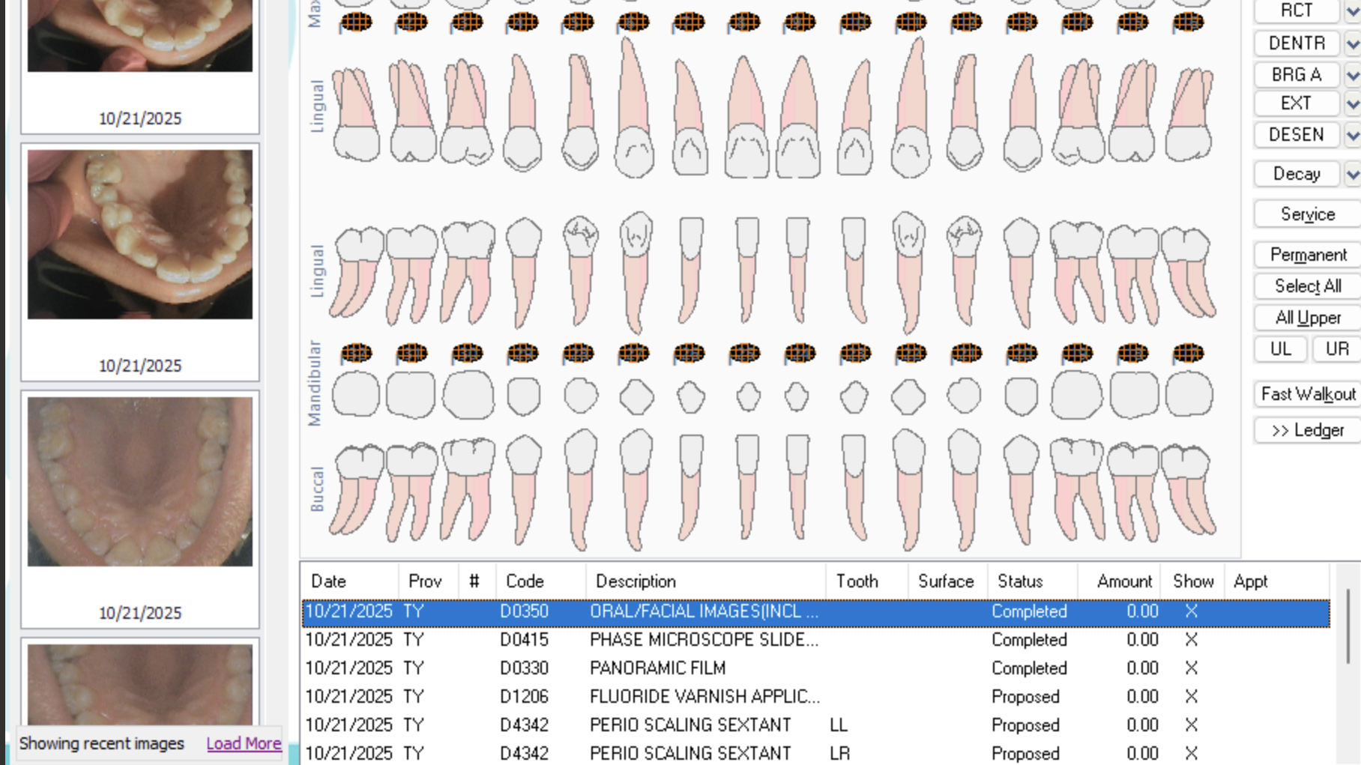
Evidence data
Patient presents with no restorations but has generalized slight to moderate attrition throughout maxillary and mandibular teeth

Slide 18
Arestin
Arestin was placed on 10/13/2025 on the mesial buccal of tooth #18

Slide 19
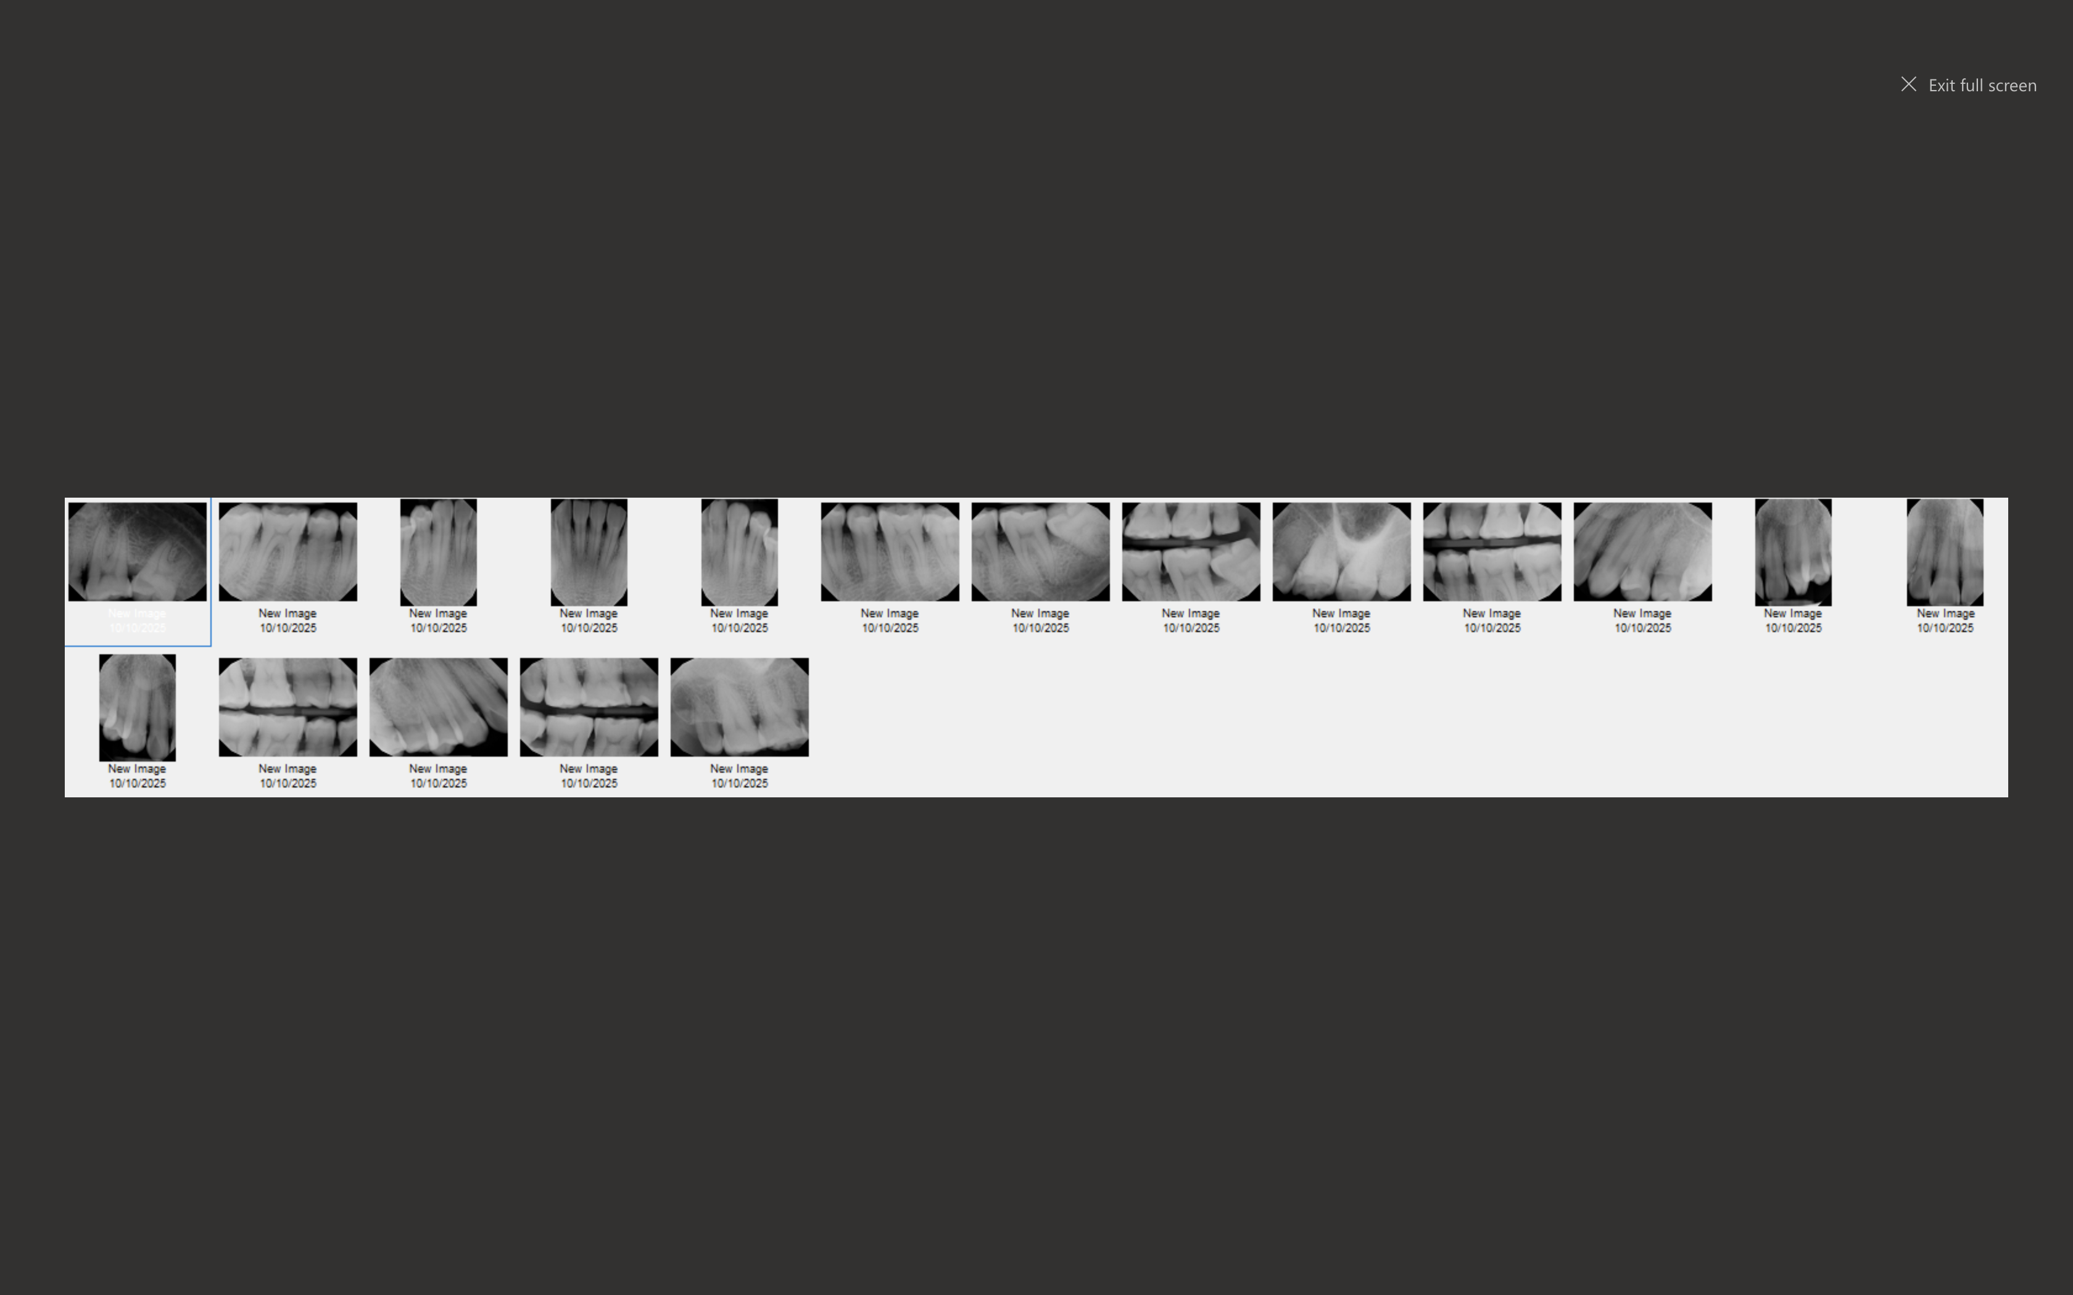
Radiographs before treatment 20 fmx (sent from Access Dental)

Slide 20
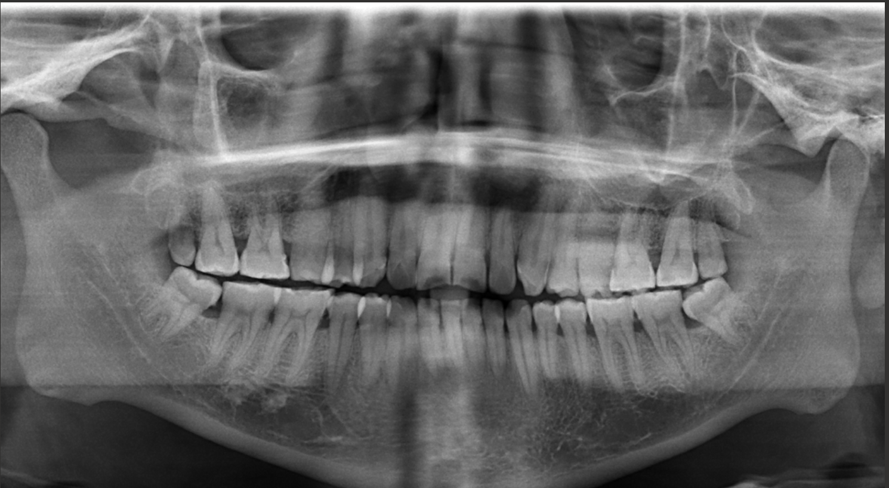
panoramic

Slide 21
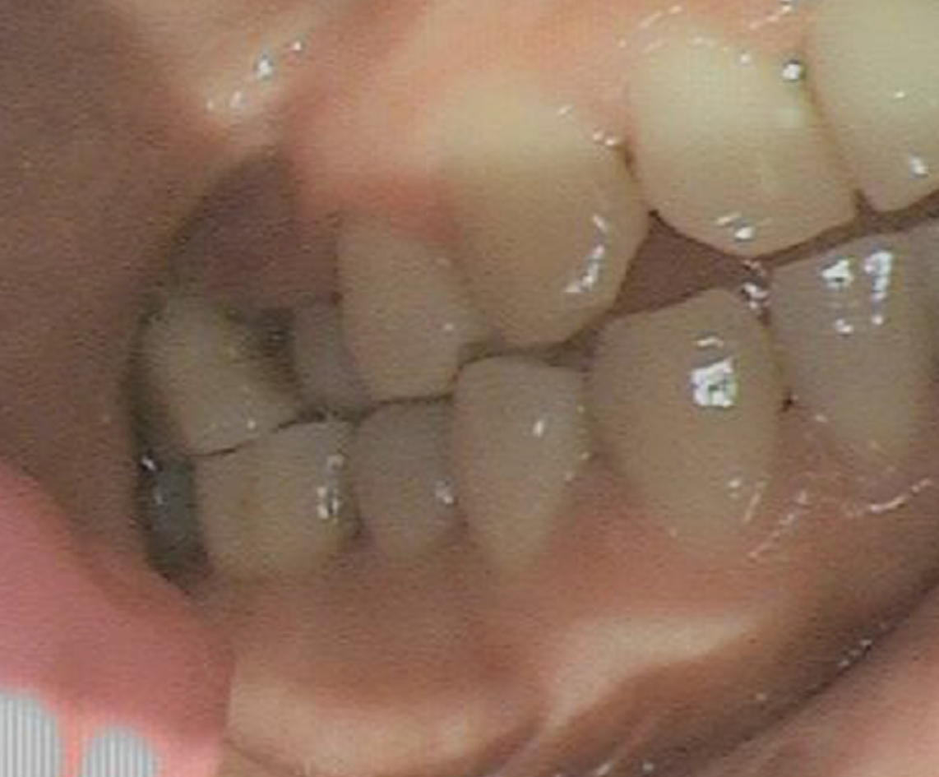
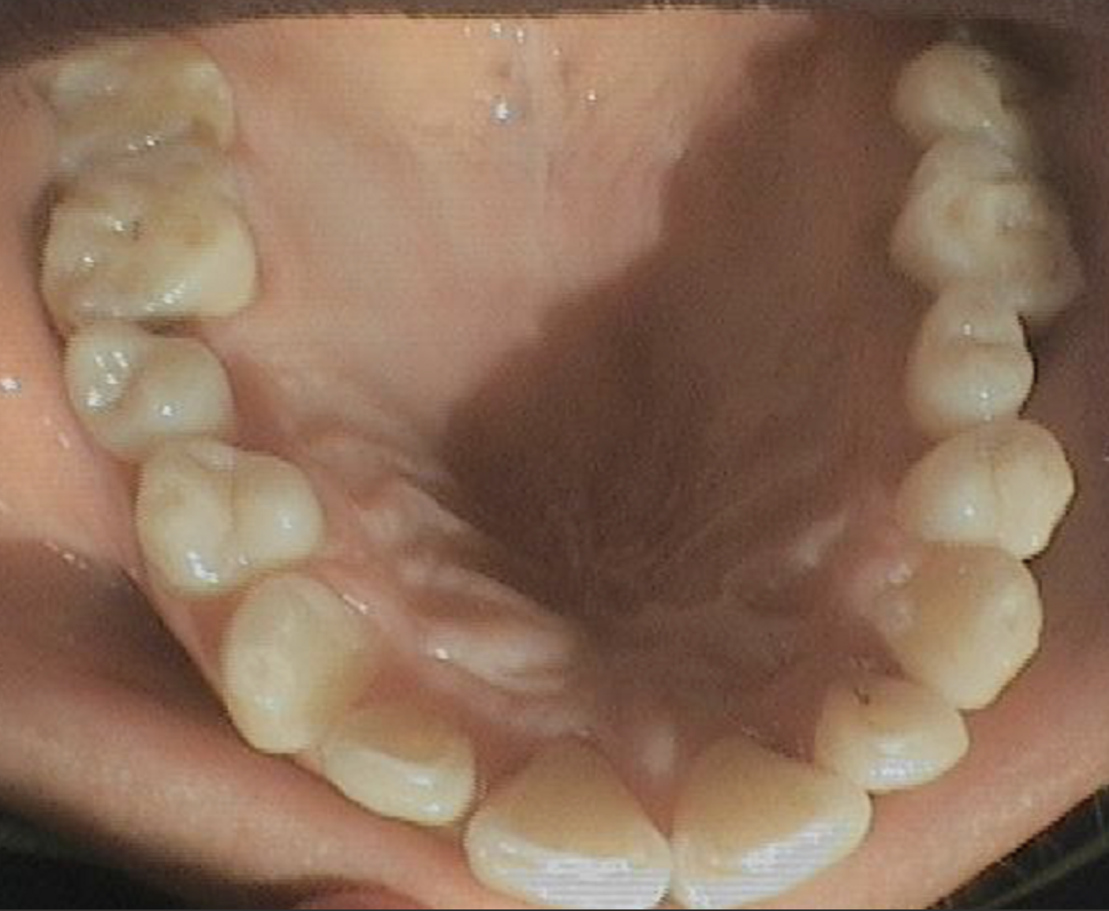
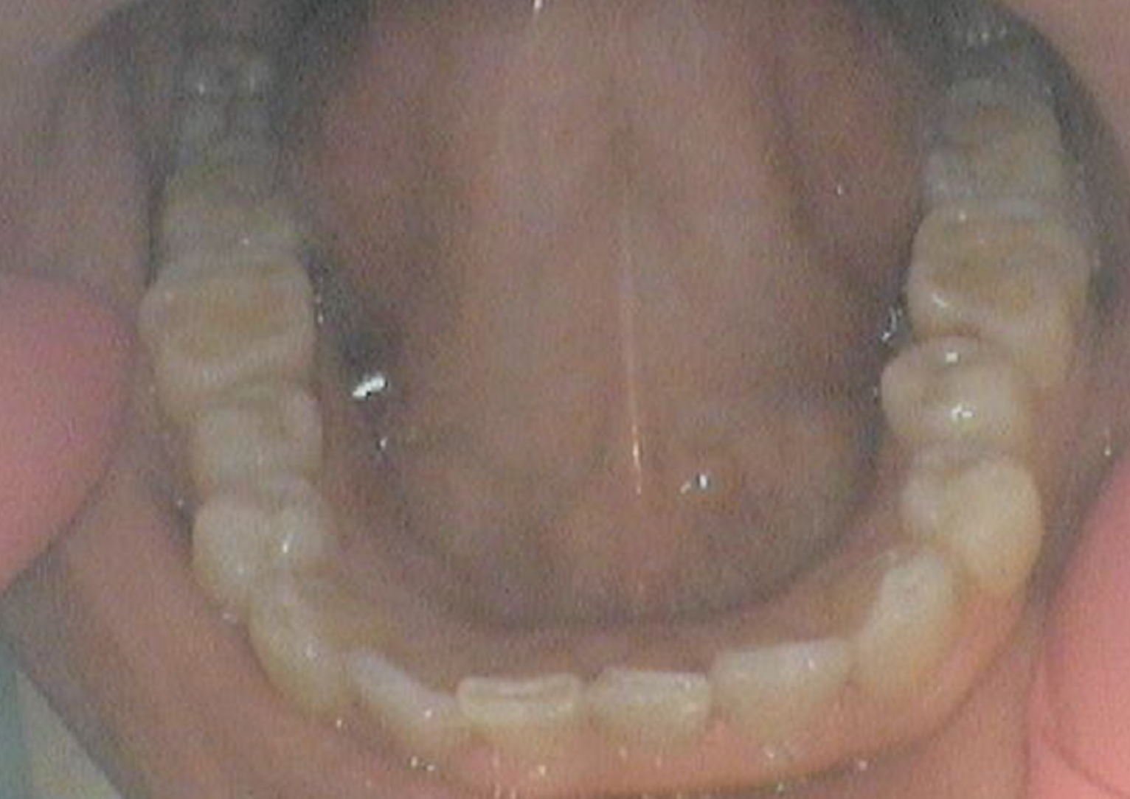
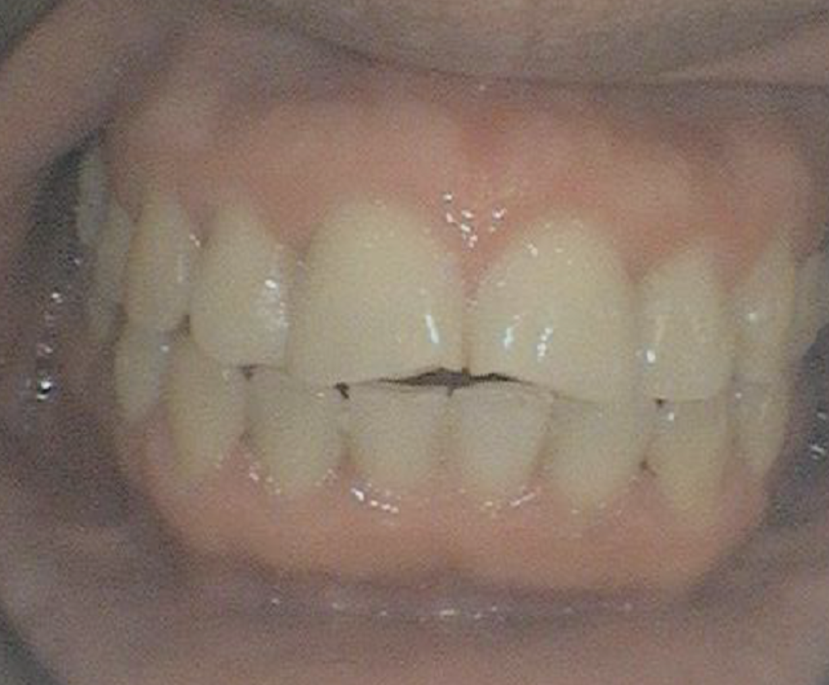
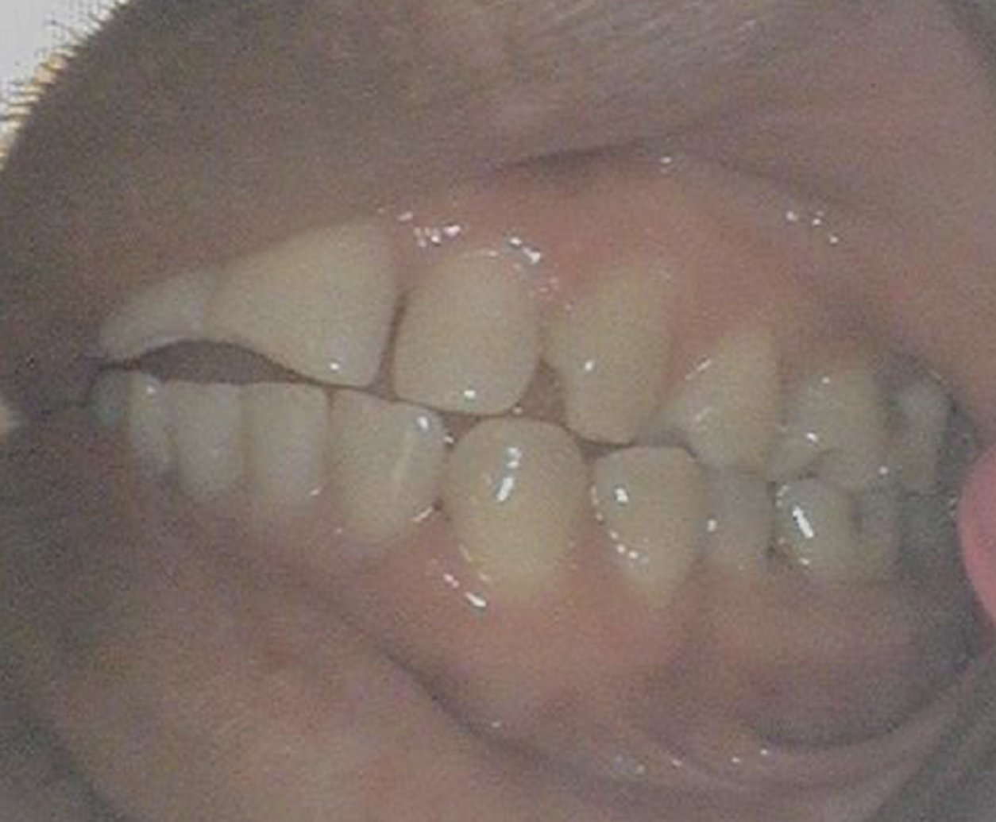
Intra- oral images before treatment

Slide 22
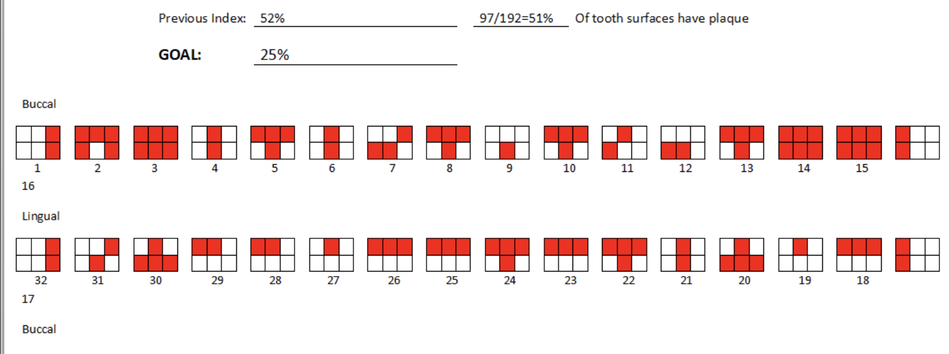
Plaque index first appointment

Slide 23

Periodontal diagnosis
Date: 10/21/2025
DOD: Q1 C3P2, Q2 C3P1, Q3 & Q4 C3P3
AAP: Stage II; Grade B

Slide 24
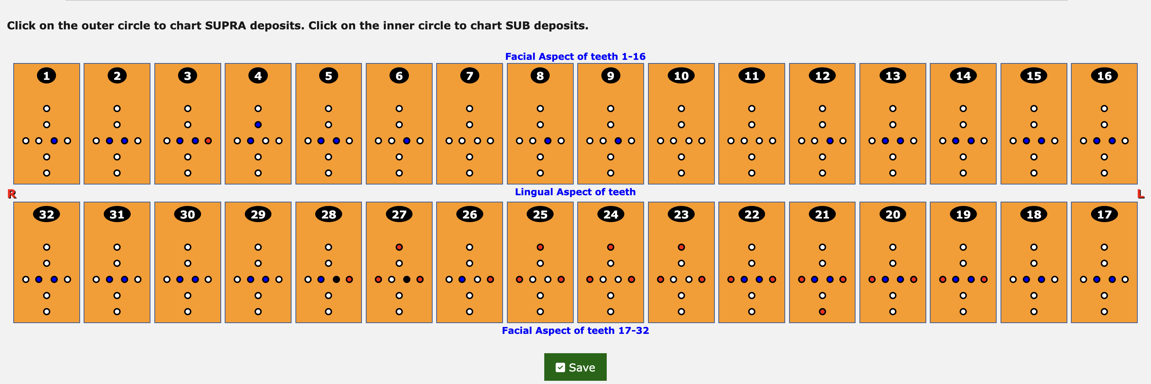
Calculus deposit assessment
Calculus assessment level –Supra- 24
Sub- 45 pieces

Slide 25
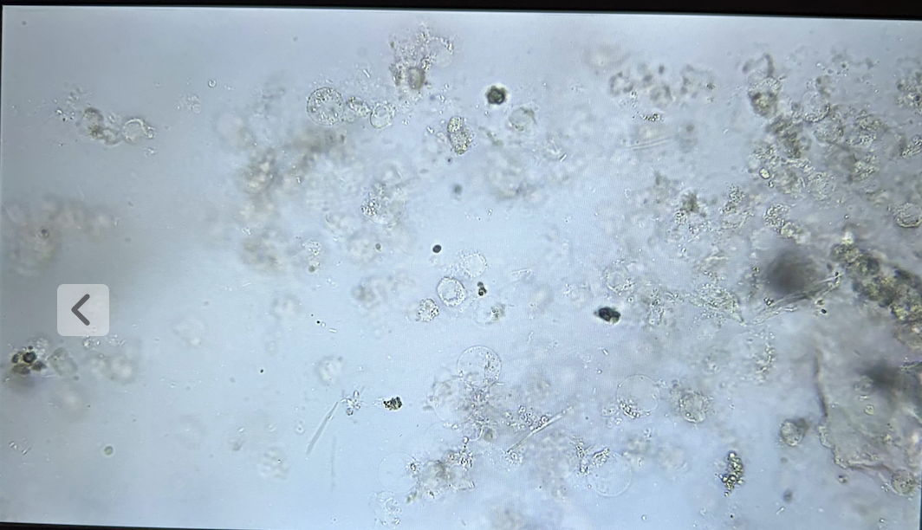
Phase microscope findings
Phase 1- 11/11/2025
Biofilm bacteria sample from #18 mesial buccal
Bacteria present: Filamentors, Spirochetes, Vibrios

Slide 26
Section iii
Dental Hygiene Care Plan & Treatment

Slide 27
Periodontal therapy
The treatment recommended periodontal therapy quads 1-4
Q1- SRP
Q2-SRP
Q3-SRP
Q4-SRP
FLUORIDE
RE-EVALUATION 6-8 WEEKS

Slide 28
Dental Hygiene Treatment Diagnosis (adpie)
Assess: Extra and intra oral examination, calculus assessment, periodontal assessment, and radiographs
Diagnose: Calculus level II & III, probing depths, generalized horizontal bone loss evident on the x-rays, best treatment option would be scaling and root planning
Plan: Oral hygiene instructions, intra oral photos, SRP Q 1-4, Fluoride varnish, Arestin placement
Implement: review treatment plan with patient
Evaluate: 6-week reevaluation

Slide 29

Timeline of appointments
10/11/2025: Afternoon appointment first started with getting his full mouth assessed and taking his Pano. Intra oral and first microscope slide on the mesial buccal of #18. Start hand scaling quad 2.
10/ 13/ 2025: Second appointment on case study. Finished scaling Q2 and start scaling Q3. Administered anesthetic for upper quad and lower quad. Scale checked both quads and placed arestin in the mesial buccal of #18.

Slide 30
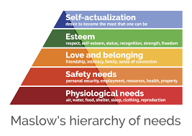
Motivation Techniques
With this patient, I used the self- actualization, safety, and the Esteem in Maslow’s Hierarchy of Needs. This patient has never been able to come to the dentist until now. I believe setting small goals for the patient will help him with his oral hygiene routine for the future. Overall, the patient is willing to learn about his oral hygiene and seems to want to continue to keep up with his teeth.

Slide 31
Dental hygiene treatment & patient response
The treatment plan included the Pano, SRP Q1-4, local anesthetic, place Arestin, comprehensive exam, & fluoride application.
The patient's response was very receptive overall. Just from the initial appointment and scaling Q1, I could already see a reduction of inflammation in the gingiva. The color of the gums is what surprised me the most. It resorted back to a pink color and more localized areas of inflammation rather than generalized.
The prediction for future appointments is reduced more of the infection in his mouth and seeing the improvement. The patient has been working on perfecting his oral hygiene routine at home and I look forward to seeing what the next two microscope slides show and the reduction of inflammation in the 6-week reeval.

