Slide 1

Nutrition and Cavities
Chrystalle Jewell, Lindsey James, Taylor Yeoman, Vanessa Benhumea
Notes:
Lindsey

Slide 2

SCAN FOR PRE TEST
Notes:
Lindsey

Slide 3

Population Needs
Struggle with sensory issues
Ex; bristles from toothbrush, taste of the toothpaste
Financial issues
Not receiving oral health care at home or via dental care
85% on Medicaid
Access to cariogenic
Notes:
Lindsey

Slide 4
Our Program Goal
Understand how nutrition and the oral cavity tie together
1
Increase knowledge on cariogenic vs noncariogenic foods
2
Be able to categorize snacks under healthy vs non healthy
3
List one reason why healthy foods are good for your teeth
4
Notes:
Lindsey

Slide 5
Learning Objectives
Visual sorting activity intended for the children ages 3-6 at the CSS Early Learning Center will be able to identify one cariogenic and one noncariogenic food.
01
Children will be able to state why one reason why cariogenic and unhealthy foods are not good for their teeth.
02
Children will be able to list one reason why their teeth benefit from noncariogenic and healthy foods.
03
Notes:
Lindsey

Slide 6
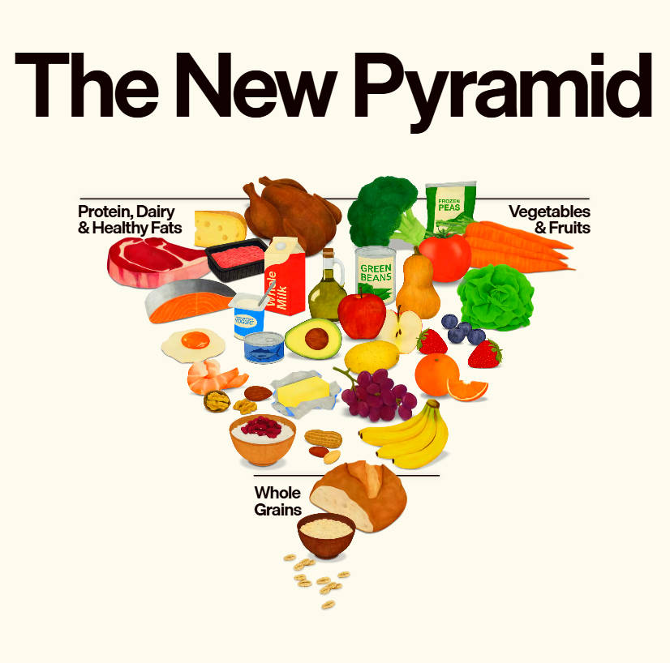
Nutrition & the Oral Cavity
A rich diet helps to support growth and development
A diet high in sugars and acids will lead to tooth decay
Reduce frequent snacking to prevent tooth decay
Visit: https://realfood.gov/
Notes:
Vanessa

Slide 7
Cariogenic vs Noncariogenic Foods
Sneaky cavity causing foods
Gummies, dried fruit- these are sticky and stay on the teeth longer
Crackers, chips, goldfish, pretzels- break down into sugars
Juice boxes, sports drinks, chocolate milk, soda, sweet tea- high cavity risk (constant sipping throughout the day)
Xylitol- stimulates secretion of saliva, antimicrobial (makes the common bacteria found in children's mouth that cause tooth decay die; S. mutans)
Notes:
Vanessa

Slide 8
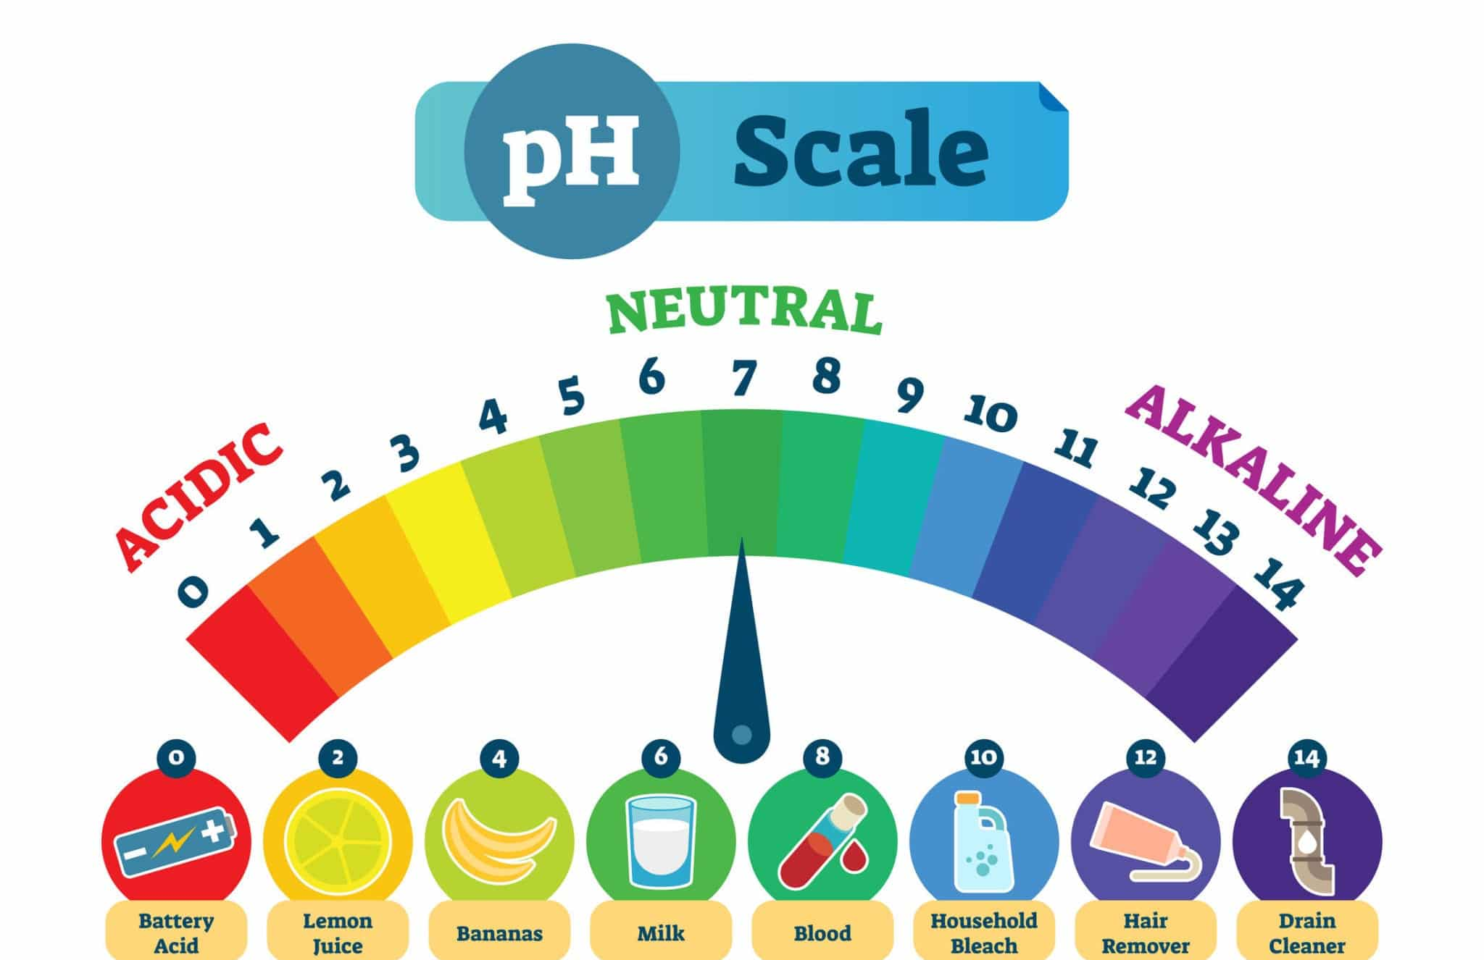
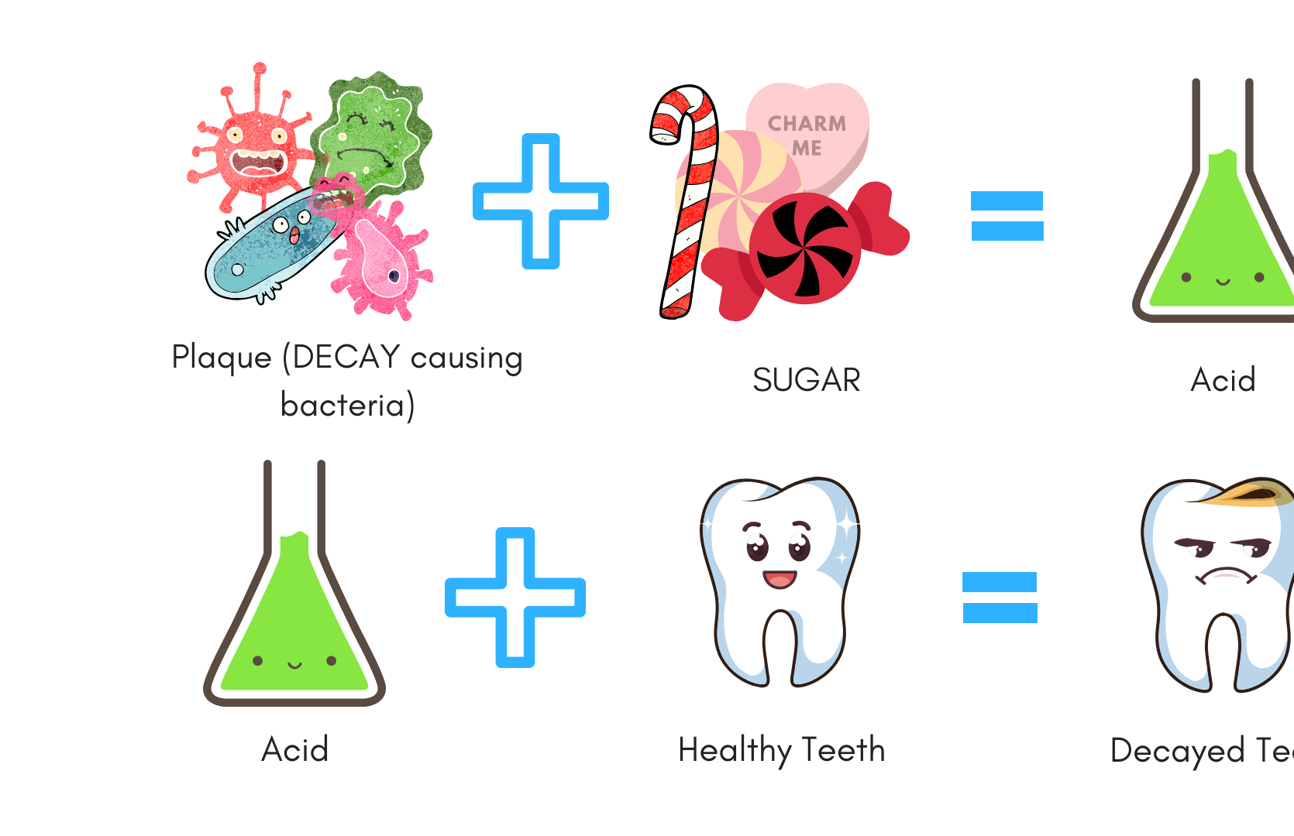
Why Frequency Matters
Every time the teeth are exposed to sugar = acid attack which lasts 20-30 minutes
Frequent snacks = mouth never recovers
Enamel erosion = below 5.5 pH
Healthy mouth = 6.2 – 7.4 pH
Best time to eat these foods is during mealtimes so it neutralizes and balances pH in the mouth
Notes:
Taylor

Slide 9
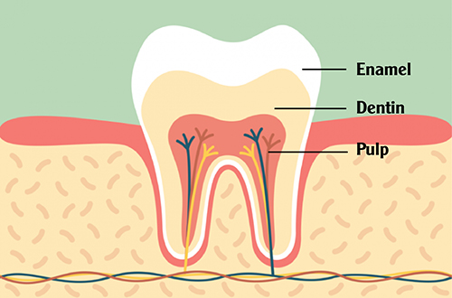
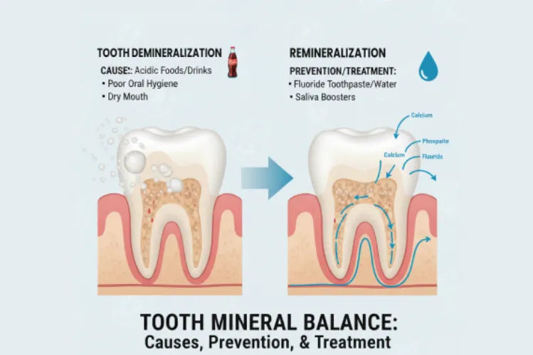
Healthy Foods
Strengthen enamel- cheese, milk, nuts, spinach
Support the bone that holds teeth in place- cheese, milk, nuts, spinach
Stimulate saliva, crunchy foods clean teeth- apples, carrots, cucumbers, celery
Water- fluoridated water helps remineralize areas on the teeth that have been demineralized
Notes:
Taylor

Slide 10
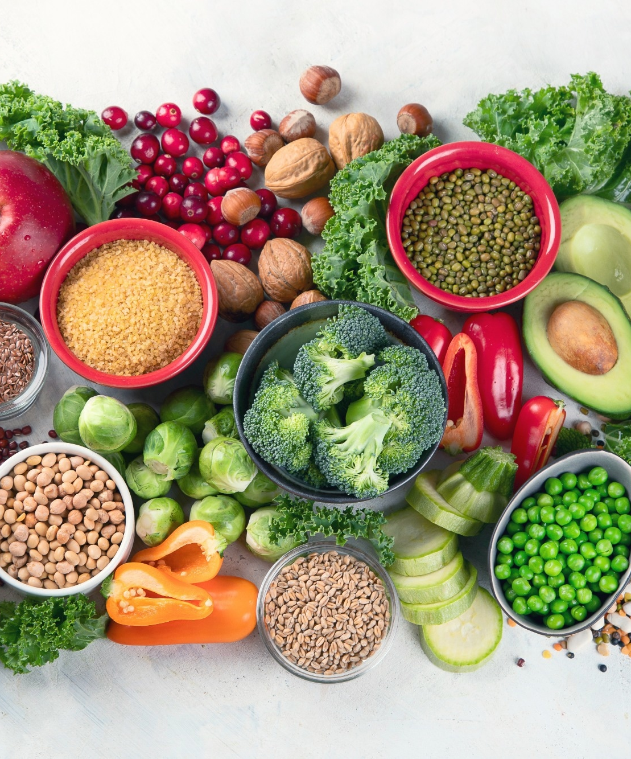
Nutrient Highlights
Calcium & Phosphorus- maintain strong teeth and jawbone
Milk, cheese, yogurt
Vitamin D- so the body can absorb calcium, mineralize bones/teeth
Milk, cereals
Vitamin C- for healthy gums
Tomatoes, melon
Vitamin A- for healthy enamel
Spinach, broccoli
Protein- helps to build/repair gum tissue
Fish, eggs
Notes:
Chrystalle

Slide 11
Conclusion
What we eat matters when it comes to our teeth
Snacking throughout the day will have the mouth in a constant acidic state
Healthy foods benefit our mouth/teeth to strengthen enamel, support the bone around our teeth, and remineralize areas that are demineralized
Poor diet affects tooth development and enamel
Notes:
Chrystalle

Slide 12
Scan for Post Test !
Notes:
Chrystalle

